Slide 1

DriverPass System Analysis
Lee Spengler

Slide 2

System Requirements
Nonfunctional
Run on any platform
DriverPass should always be available
Functional
DriverPass will validate users using a Username and Password
Customer’s will be in control of their experience
Notes:
Nonfunctional vs Functional
We are not talking about something working vs not working
When we talk about functional vs nonfunctional requirements, functional requirements talk about what the system does, where as nonfunctional requirements talk about how the system does what it must do.
Nonfunctional
Run on any platform
We don’t know what our customers will be using so our system should be designed to load quickly, and work correctly no matter if the customer is on a mobile device or a more standard computer.
To do this it will be designed as a web-based product that can be used on all of the popular web browsers.
DriverPass should always be available
We never know when our customers will want to use the system, because of this we want to make sure they can get to it any time 24/7
To ensure that it is always available we should use cloud based servers to make sure we will have little to no downtime.
Functional
DriverPass will validate users using a Username and Password
We must ensure a secure system if we want our customers to make use of it
We also need to differentiate between employees and customer
This is a system familiar to our customer base.
Customer’s will be in control of their experience
Customer’s can setup their own accounts, and modify them when they want
Customer’s can pick their training package for themselves
Customer’s can setup their own test drive appoinments to fit their schedules
Customer’s can go through study materials as quickly or as slowly as they like whenever they want.

Slide 3
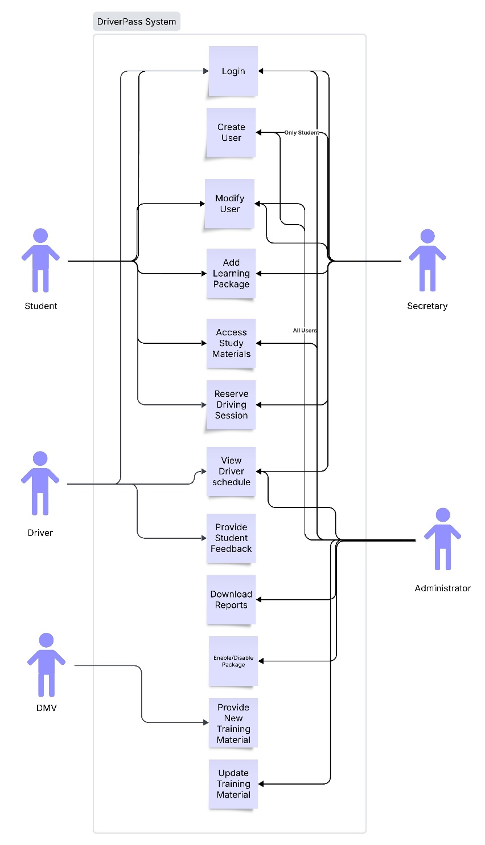
Use Case Diagram
Notes:
Actors in the DriverPass System
We have 5 different actors in the driver pass system
4 of them are kinds of users, Administrators (who have full control), Secretaries (who can create students, and handle any tasks they may need), Drivers (our training instructors), and students (our customers)
The final actor is the DMV who we will be interacting with to get updates for any new training materials
Different use cases
For our different use cases I wanted to include all of the likely functions we are going to want out of the system.
We see that Students and Secretaries(on behalf of students) can modify the student information, including personal information, what package is being added to the account, setting up driving practice reservations.
Students can access their training materials
Drivers can see their scheduled appointments and provide feedback to students about their driving
Administrators will have access to the status information about any driver or student, as well as be able to add or remove service packages whenever the business needs a change.
Administrators will also have access to offline reports for whatever they need
The DMV can provide information whenever driver training material changes.
All direct users are able required to login to make use of the system

Slide 4
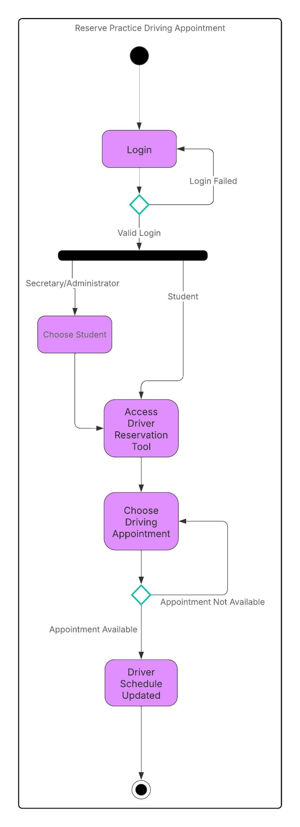
Activity Diagram
Notes:
Activity Diagram
Here we can see the flow of how the system is going to allow for the reservation of a driving practice session
To start we are showing a user required to login as anything done in the system will require a login for security purposes
Next we see a point where the process diverges between a Secretary or Administrator user setting up an appointment vs a normal Student User
The main difference as you can see is that a Secretary or Administrator user will need to select which student they are reserving the appointment on behalf of, a student does not need to do that as they will only be reserving for themselves.
After a student is chosen or logs in the user will move on to the reservation system.
A user can pick from a calendar a date and time for an appointment, if someone else reserved that slot after the calendar loaded, it will display a message and reload the calendar. (just like buying a movie ticket with assigned seats online)
If the slot is available the calendar will be updated and the Student will receive a confirmation, then the process is complete.

Slide 5
Security
Any User must login to access any part of the system
Access is limited by role
User data is encrypted for compliance
Notes:
Security
Any user must login to access any part of the system
In order to make sure our system is protected a user must login to access any part, if a user tries to get to a part of the system without logging in they will be redirected to the login page.
Access is limited by role
What a user can do when logged in is limited by their role
The roles are Administrator, Secretary, Driver, and Student
In this way information will be kept private, and people cannot access material that they have no reason to.
User data is encrypted for compliance
Government regulations require we protect customer information, most notably payment information must be secured to be PCI compliant.
We would also want to avoid a leak of customer data, as that would be a public relations nightmare.

Slide 6
System Limitations
The system does not work offline
The system does not function when not logged in
The system does not allow package changes at this time
The system does not allow voice control
The system cannot book an appointment without a student and a driver associated
Notes:
Limitations
We do need to talk about some things the system cant do, so we can be prepared in the future
The system does not work offline
Nether users or the system will be able to function without an internet connection
Steps will be taken to prevent the system from losing connection and going offline
Students cannot access training materials offline
The system not function when not logged in
As discussed in the security section the user’s role is intrinsic to how the system functions, as such a user must be logged in
The system does not allow package changes at this time
Any changes to offered packages must be done by a developer in this release
In the future we hope to allow the Administrator users to make package changes
Currently they can only turn packages on and off
The system does not allow voice control
System only supports mouse and keyboard
Modified to allow mobile devices to function
The system cannot book an appointment without a student and a driver associated.
Any appointment must have a student and a driver associated
This will prevent double booking of students or drivers when scheduling appointments

